Slide 1

THE WEB WEAVER’S
WE BUILD THINGS FOR THE WEB

Slide 2
ABOUT US
We’re a team of Web Developers and Front & Back End Engineers and Database Handler work together with our full potential to provide you with our level best services to meet your expectations.
We're passionate about creating and developing clean, unique, elegant products. We specialize in building Websites for small to medium size business. We keep our code clean, readable, modular and well refactored. We enjoy working with complex user interfaces .

Slide 3
PURPOSE OF WEB DESIGNING & DEVELOPMENT
Makes Navigation Easy.
Get to Win with SEO(Search Engine Optimization).
Provide Visual Content on the Website.
Increase the Sales.
Attract Lifetime Clients to your Business.
Reach Out to More Clients.
Improving User Engagement.
Resourceful in Marketing & Advertising.
Streamlining the Brand.
E-commerce.

Slide 4
SERVICES WE PROVIDE
WEB DESIGN
WEB DEVELOPMENT
UI / UX DESIGN
RESPONSIVE WEB
DATABASE

Slide 5
FRONT END
For Designing the Front End Page , We used HTML , CSS and JAVASCRIPT.
All the Design is responsive done with HTML.
The Animation and Graphics is done with CSS.
The Validation is done with JAVASCRIPT.

Slide 6
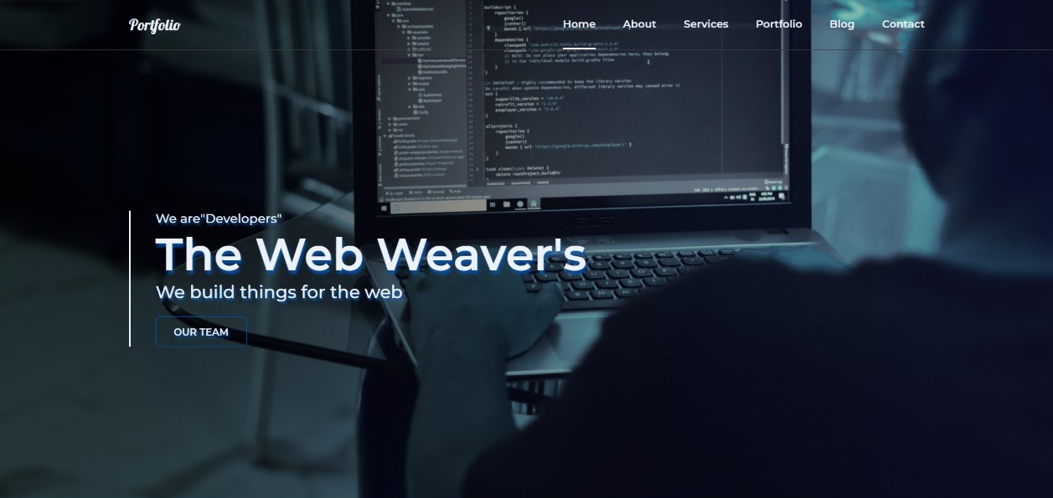
SNAPSHOT

Slide 7
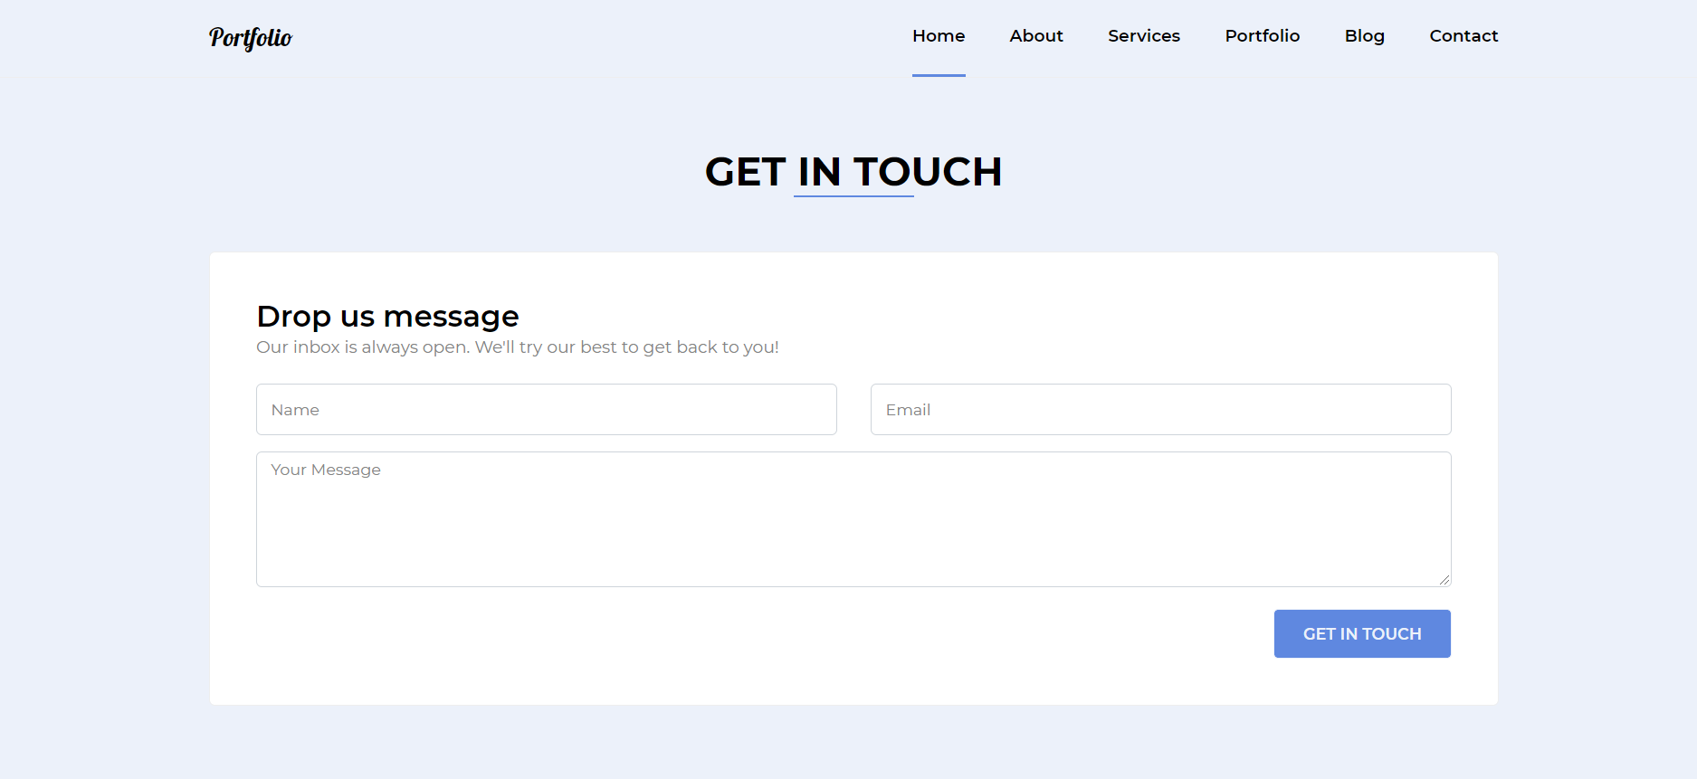
SNAPSHOT

Slide 8

TEAM MEMBERS
SAKSHI TYAGI
MUKUL DHAMA
ASHWANI CHAUDHARY

Slide 9
CONCLUSION
The Web Weaver’s is a Web Designing & Developing platform with a specialization in providing the User with our best services . We are a team which creates websites for the user for small to medium level business. We try our level best to meet the expectations of the user the first time and provide them help & support whenever they need with whatever they need.

Slide 10

Thank You…

